Slide 1
SIMATS ENGINEERING
CAPSTONE PROJECT
Analysis and Implementation of Post-Quantum Cryptography
CSA5193-CRYPTOGRAPHY AND NETWORK SECURITY FOR SECURE SYSTEM DESIGN
Supervisor
Alphonsa.J
Presented By:
Ch.Durga Narendra (192211285)
V. Chakravathi (192211907)

Slide 2

Introduction to Post-Quantum Cryptography
Post-quantum cryptography (PQC) is a new type of cryptography that is resistant to attacks by quantum computers. It is essential to prepare for the future of cryptography.

Slide 3

Need for PQC
Quantum computers pose a threat to classical cryptography. They can break widely used algorithms such as RSA and ECC. PQC is designed to withstand these threats.
Security
Interoperability
PQC provides a solution to the threat posed by quantum computers.
PQC enables the continued use of digital communication and transactions.
Future-Proofing
PQC ensures the long-term security of our digital infrastructure.

Slide 4




Quantum Computing and its Threat to Classical Cryptography
Quantum computers leverage the principles of quantum mechanics. They can perform computations that are impossible for classical computers.
Factoring
Quantum algorithms can factor large numbers efficiently.
Discrete Logarithms
Quantum algorithms can solve discrete logarithm problems efficiently.
Threat to Cryptography
These algorithms can break widely used cryptographic systems.

Slide 5
Lattice-Based Cryptography
Lattice-based cryptography is one of the leading candidates for PQC. It relies on the mathematical properties of lattices.
Hard Problems
Key Features
Examples
It leverages the hardness of certain lattice problems, such as the Shortest Vector Problem.
Provides various cryptographic schemes like encryption, digital signatures, and key exchange.
Notable schemes include NTRU, Kyber, and Dilithium.

Slide 6

Code-Based Cryptography
Code-based cryptography uses error-correcting codes for encryption and decryption. It is based on the difficulty of decoding certain codes.
1
McEliece Cryptosystem
2
Code-Based Signatures
3
Security
One of the oldest and well-studied code-based cryptosystems.
Offers digital signature schemes based on the hardness of decoding.
The security of code-based cryptography relies on the hardness of decoding.

Slide 7
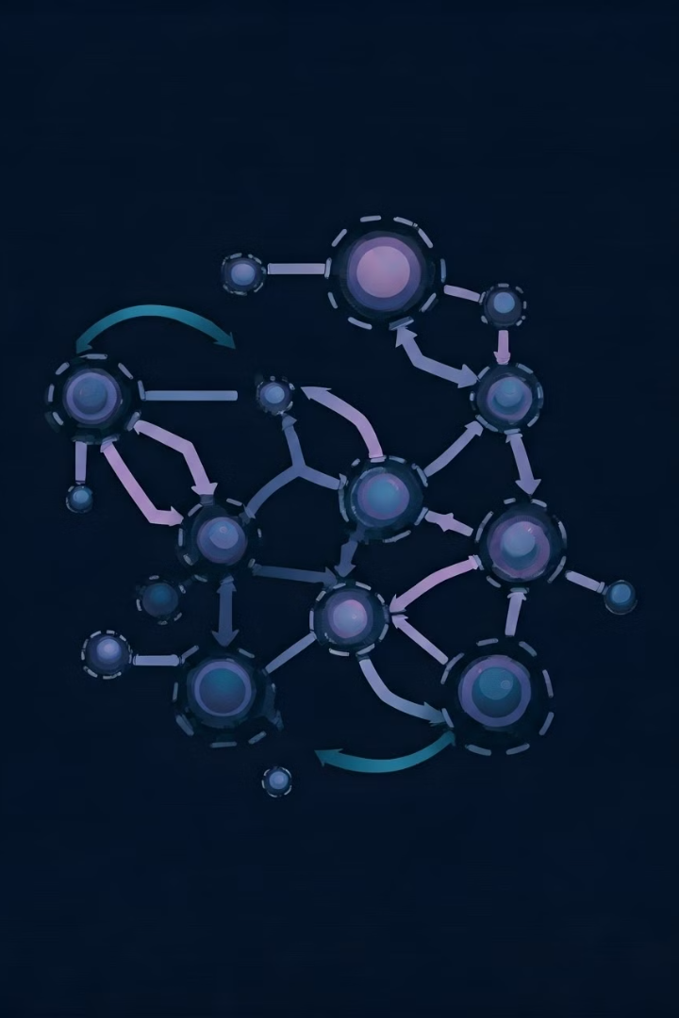
Multivariate Cryptography
Multivariate cryptography uses systems of polynomial equations for encryption and decryption. It leverages the difficulty of solving such systems.
Advantages
Offers efficiency and high performance.
Disadvantages
Vulnerable to specific attacks.
Research
Active research focuses on improving security and robustness.

Slide 8




Hash-Based Cryptography
Hash-based cryptography uses hash functions to create cryptographic primitives like digital signatures. It offers provable security.
Digital Signatures
Security
Performance
Provides strong and secure digital signatures.
Based on the assumption that finding collisions in hash functions is infeasible.
Performance can be relatively slow compared to other PQC approaches.

Slide 9


Standardization Efforts for PQC
Standardization efforts are crucial for PQC. They ensure interoperability and widespread adoption of PQC algorithms.
NIST
ETSI
NIST is leading the effort to standardize PQC algorithms.
ETSI is also actively involved in standardizing PQC algorithms.

Slide 10

Challenges and Future Directions in PQC
PQC research continues to address challenges such as performance, efficiency, and key size. Research focuses on developing more efficient and robust algorithms.
1
Performance Optimization
2
Key Size Reduction
Reducing the size of PQC keys to minimize storage and communication overhead.
Improving the performance of PQC algorithms to meet practical needs.
3
Real-World Deployment
Transitioning PQC algorithms from research to practical deployment in various applications.

Slide 11
Thank You!

